Slide 1

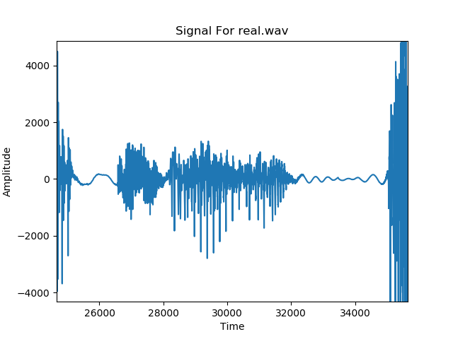
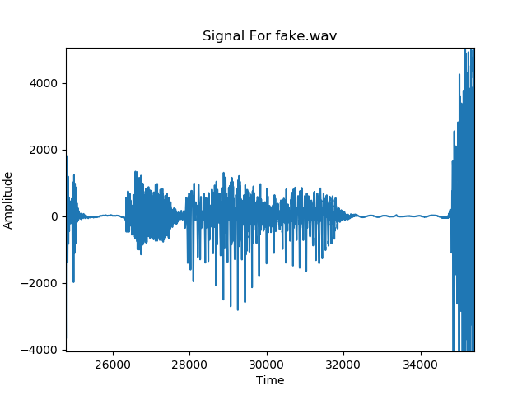
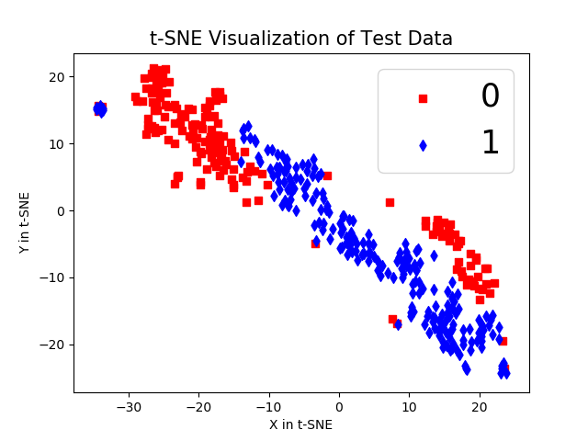
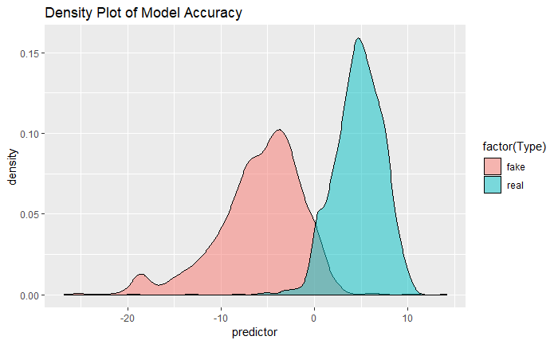
Automated Detection of Artificial Voices
Student: Vivek Sharath Supervisors: Alex Liu Lab: SISL
Signal of a
Real Voice Clip
Signal of a Synthetic Version of the Same Clip
Statement of problem
How can we differentiate between a real & a generated voice?
Approach
Using the given real audio wav files, use Sprocket (an open-source voice converter) to create converted voice wav files.
Both real and fake wav files will comprise the data set
Extract the MFCC for every real and fake audio wav file and write the output to a 52-feature matrix
Explore and visualize the MFCC data using t-SNE
Use the MFCC data to train and test a logistic regression model
Background/Motivation
Voice Conversion is the modification of one speaker’s voice (the source) to sound like another speakers voice (the target)
Generated voice quality has improved over the years which makes detecting real and converted voices increasingly difficult
For this project, we will use an open source voice conversion tool to produce numerous converted voice clips
What is needed
Several authentic audio recordings
A voice conversion tool
MFCC (Mel-frequency cepstral coefficients) algorithm that extracts features in a voice clip
Machine learning model to classify voice clips as real or fake
Accomplishments/results
Generated 1728 fake voice clips using Sprocket
Successfully trained a logistic regression model that was able to differentiate authentic & generated voice wav files with 82% accuracy

